Slide 1
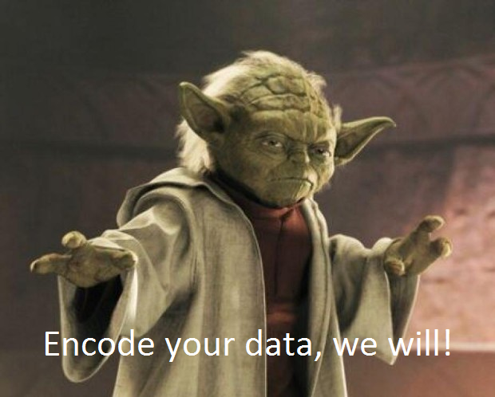
The YAML Observation Data Archive & Exchange (YODA) Format

Slide 2
The YODA File Format
Follows the syntax format of YAML, which can be easily parsed by most computer languages.
Uses the tables and vocabularies of ODM2
Replaces the original CZO Display File
Serves as both a data transfer and a data archive format.
Draft specifications: https://docs.google.com/a/stroudcenter.org/document/d/1J-AMOavHkazpcaKVGzhVY_yIipkOZDzYHjV0I_IiEuk/edit#

Slide 3
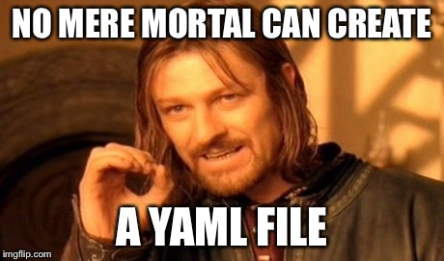
Unfortunately….

Slide 4
Excel Template Tools
Require Excel 2007/2010 and macros
Two versions in development:
sensor-based time series data
specimen-based measurements
Generate a complete, well formatted YODA file that can be submitted on the CZO website and parsed into a central ODM2 database.

Slide 5

Limitations of the Templates
Still in development!
Should have a release out within ~2 weeks.
Would really appreciate some willing beta testers!
Do not allow input of all the details available in ODM2 without manually editing YAML.
YAML doesn’t look like a typical csv or data table that people are used to seeing.

